Slide 1
SS ZG653 (RL 13.1): Software Architecture Adaptable Systems
Instructor: Prof. Santonu Sarkar

Slide 2
microkernel
Adaptable Systems

Slide 3
Microkernel – 3 part schema
Context
The development of several applications that use similar programming interfaces that build on the same core functionality
Problem
Developing software for an application domain that needs to cope with a broad spectrum of similar standards and technologies
Continuous evolution (software and hardware), platform must be extensible, portable and adaptable
Solution- Microkernel
Encapsulate the fundamental services of in a microkernel component
Often encapsulates the hardware dependent aspects
Allows other components to interact with microkernel through well-defined API
Size should be really small

Slide 4
Microkernel
Client
Adapter
External Servers
Internal Servers
Microkernel

Slide 5
Participating Components
Internal Servers
Implements additional services, typically device drivers
Runs as a process or a shared lib
External Servers
More complex functionality for the clients. Typically run as separate processes
Adapters
Provides interface between external server and client
Clients
Microkernel
Only core functionality + communication mechanism
Interacts with Internal server

Slide 6
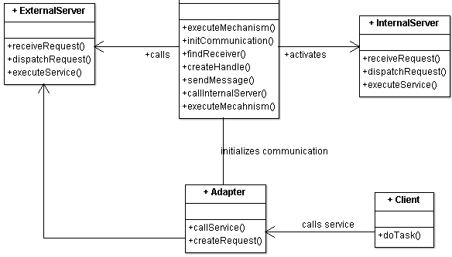
Microkernel
Main component of the pattern, which is optimized for memory
Provides core mechanisms
Encapsulates system specific dependencies : Hardware dependent parts
Maintain system resources such as Processes, Files
Provides a set of atomic services- known as mechanisms
More complex functionality can be built by composing these atomic services
In OS design, Microkernel would run in the privileged mode
Everything else runs in user mode
Microkernel

Slide 7
Server
Internal Server
External Server (aka Personality)
Also known as subsystem
Extends functionality provided by Microkernel
Microkernel invokes services based on client requests
Example: Device drivers
Consider as extensions which are accessible to microkernel only
Implements it’s own ‘view’ of the underlying microkernel
E.g. OS/2 flavor on top of microkernel
MacOS on top of microkernel
Different servers implement different policies for specific application domains
Perform:
Receives service requests from client applications using the communication facilities provided by the microkernel
interprets these requests
executes the appropriate services
returns results to the clients

Slide 8
Client
Client
Adapter
Represents an application
Associated with exactly one external server
No direct communication, through Adapter only
Accesses the services provided by the external server
thru adapter as a service request
Protect the client from implementation details of the microkernel
Uses communication mechanism provided by the microkernel
Service requests from client
forwards the call to the appropriate server
Invokes methods of external servers on behalf of clients

Slide 9
Microkernel Layered design
App-1
App-2
App-3
App-4
Adapter
External
Server
External
Server
External
Server
Microkernel
Internal
Server
Internal
Server
Internal
Server
Internal
Server

Slide 10
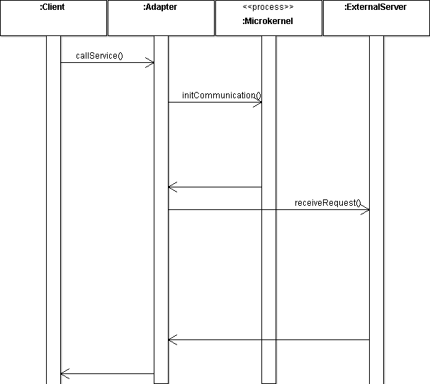
Client Request
createRequest()
findReceiver()
Determines the address of the external server
dispatchRequest()
Possibly an RPC
executeService()

Slide 11
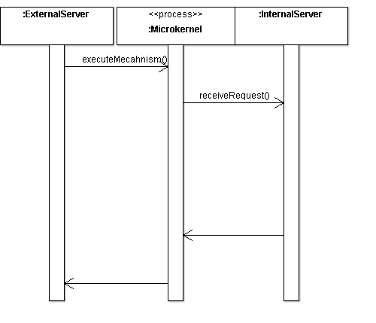
External Server Request
callInternalServer()
External server requests a service to microkernel
This service is provided by an internal server
Internal server can be a separate process or a shared library
executeService()

Slide 12
Microkernel Detailed
RL 13.2

Slide 13
Implementation
# | Steps
1 | Analyze the application domain
2 | Analyze the external servers
3 | Categorize the servers
4 | Partition the categories
5 | Find a consistent and complete set of operations and abstractions
6 | Determine strategies for request transmission and retrieval
7 | Structure the microkernel component
8 | Specify the programming interfaces for the microkernel
9 | Microkernel is responsible for all the system resources
10 | Design and implement the internal servers
11 | Implement the external servers
12 | Implement the adapters
13 | Develop client applications

Slide 14
Client Requirement
2. Analyze External Servers
1. Analyze Application Domain
Identify the functionality required
Perform analysis to identify policies the external servers need to offer for the application domain
Analyze the policies the external servers are going to provide to define
High level interfaces required to be provided
List of services and service categories necessary

Slide 15
Category of Core Services
3. Categorize Services
4. Partition categories
Identify all core service functionality
Group them into a set of semantically-independent categories
Example: memory mgmt, process mgmt, low level I/O, communication
Identify categories which are not directly related to application domain
Page handler for processes, file system mgmt
Focus is to build the system infrastructure
Separate the categories of services that should belong to microkernel and internal servers
Typically based on frequency of use or hardware dependent will be part of microkernel
Page fault handlers, drivers and file system form part of internal servers

Slide 16
Core Service Design
5. Identify operations for each category
6. Determine communication strategies
Find a consistent and complete set of operations and abstractions
Microkernel provides mechanisms for the policies of external server; each policy is implemented thru use of services the microkernel offers
Example
Creating and terminating processes and threads
Specify the facilities that microkernel should provide for communication between components
Synchronous/Asynchronous
Relationship: one-to-one, many-to-one or a many-to-many
Build core services of message passing or shared memory, based on which the other services can be built

Slide 17
Microkernel
8:Specify the microkernel API
7:Structure the microkernel component
Separate system-specific parts from system-independent parts
Use Layer pattern
Lowermost – system specific
Uppermost – system independent; focusing on the services which microkernel will expose
Decide how the interfaces should be available externally
Microkernel as a
Separate process
Module physically shared by other components
Main Quality attribute: Efficiency and not make microkernel a bottle neck

Slide 18
Resource Management
9:Design Microkernel resource mgmt
10:Design & Implement Internal Servers
Implement strategies for sharing, locking, allocation and deallocation of resources
Maintain the information about resources and allow access to them in a coordinated and systematic way
Separate processes or shared libraries centered around resources
Active servers are implemented as processes
Passive servers are implemented as shared libraries
Graphics card driver → shared libraries
Page fault handler → separate processes

Slide 19
Client Access
12:Implement adapters
11:Implement external servers
Each external server is implemented as a separate process that provides it’s own service interface
Internal architecture depends on the policies it comprises
Specify how external servers dispatch requests to their internal procedures
Decide on strategy of adapter; one adapter for all clients or every client associated with one adapter (trade off)
Adapter needs to package all relevant information into a request and forwards the request to appropriate external server
Use “Proxy” pattern

Slide 20
Variants
Microkernel system with indirect Client-Server connections
Distributed Microkernel System

Slide 21
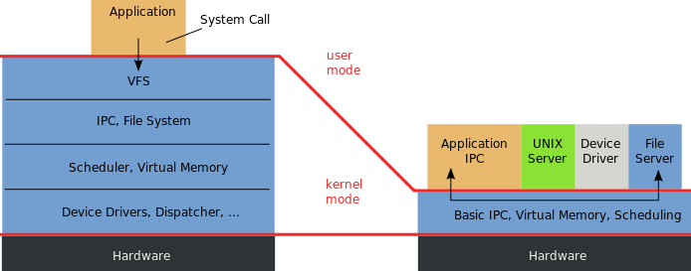
Example
While Traditional BSD kernel was monolithic, microkernel architecture is loosely coupled
During startup microkernel-based system requires device drivers (internal server), which are not part of the kernel.
This means that they are packaged with the kernel in the boot image, and the kernel supports a bootstrap protocol that defines how the drivers are located and started;
https://en.wikipedia.org/wiki/Microkernel

Slide 22
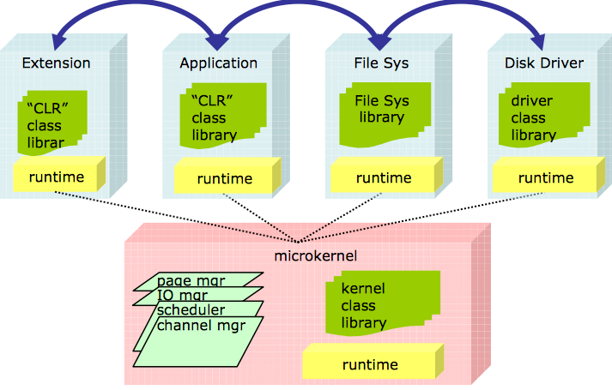
Microsoft’s Singularity OS
Microkernel provides memory mgmt, process creation, communication, scheduling and I/O
Kernel calls only passes value
A process can’t change the state of another process
Code in Singularity is either verified by the compiler or trusted
Software isolated processes
Encapsulates applications for failure isolation
http://research.microsoft.com/pubs/52716/tr-2005-135.pdf

Slide 23
Relationship with Other Patterns
Broker
Coupling
Broker is decentralized
Microkernel is more tightly coupled
Client communiction
In broker, clients communicate via message passing
Microkernel uses adapter strategy so that clients do not call the service directly
Layer
Microkernel can be thought of as a variant of layered architecture
Each layer is a VM
Lowest layer – internal server
Middle layer external server+adapter
Topmost layer – client application

Slide 24
Pros and Cons
Benefits
Liability
Portability
Flexibility and Extensibility
Separation of policy and mechanism
Easy to ensure security as everything else can run in user mode
Scalability
Reliability
Transparency
Performance is worse than a monolithic kernel
Much more IPC due to internal and external servers, unlike a monolithic solution
Complexity of design and implementation

Slide 25
Known Uses
Amoeba operating System
Chorus
Windows NT
Symbian
iOS – based on Darwin which is a microkernel architecture
Find (at least 2) more popular uses and document them
Conceptual Architecture of the Linux Kernel http://docs.huihoo.com/linux/kernel/a1/index.html

